Slide 1
BEC MICRO-PROJECT
PHOTO DIODES
Guided BY MS. LUBNA Shaikh

Slide 2
PARTICIPANTS
210451 – ABDURRAHMAN QURESHI
210459 – OWAIS KHAN
210461 – TEJAS JAGTAP

Slide 3
PHOTO DIODES

Slide 4
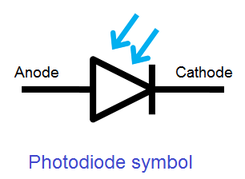
WHAT ARE PHOTODIODES?
A photo diode or a photodetector is an optoelectronic device that absorbs optical energy and converts into electrical energy.
Which usually is shown as a photocurrent. Photodiodes are specially designed to operate in reverse bias condition.
These diodes have a slow response time when the surface area of the photodiode increases.

Slide 5
THE PHOTODETECTION PROCESS
There are three steps involved in photo detection process, they are:
1.Absorption of optical energy and generation of carriers.
2.Transportation of photo generated carriers across the absorption and/or transit region with or without gain.
3. Carrier collection and generation of a photocurrent, which flows through the external circuitry.

Slide 6
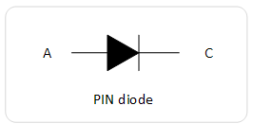
HOW A PHOTODIODE WORKS?
In reverse bias condition, the minority carriers generated are recombined before they reach the junction.
Therefore no current will flow through the junction.
So an external energy should be applied at the depletion region to increase the population of the minority carriers and thus increase in the current flow.

Slide 7
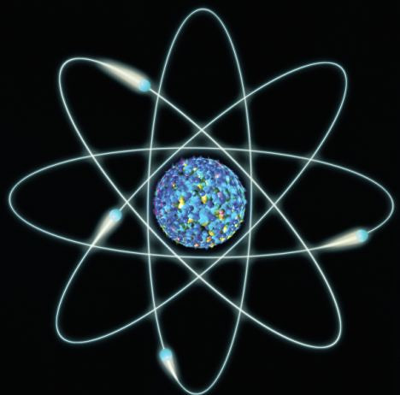
To overcome this problem a special diode called photodiode is used.
Photons or light is used as external energy to generate more number of minority carriers.
when a photon of ample energy strikes the diode, it makes a couple of an electron-hole. This mechanism is also called as the inner photoelectric effect.
Therefore holes move towards the anode and electrons move towards the cathode, and a photo current will be generated.

Slide 8

When no light is applied to the reverse bias photodiode, it carries a small reverse current due to external voltage. This small electric current under the absence of light is called dark current. It is denoted by I _{λ}.
The total current through the photodiode is the sum of the dark current and the photocurrent. The dark current must be reduced to increase the sensitivity of the device.

Slide 9
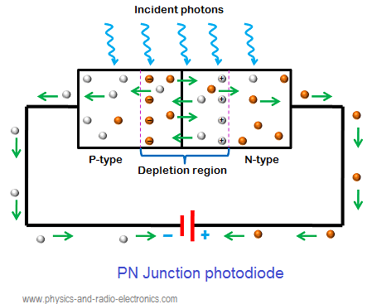
Diagram Of PN Junction Photo-Dioide

Slide 10
PERFORMANCE PARAMETERS
Responsivity, R: The responsivity of a silicon photodiode is a measure of the sensitivity to light, and it is defined as the ratio of the photocurrent IP to the incident light power P at a given wavelength,λ:
R = IP
P

Slide 11
QUANTUM EFFICIENCY:
The number useful electron hole pairs generated per incident photon. this is external quantum efficiency.
η = no of useful electron hole pairs generated
no of incident photons per unit time

Slide 12
Response time or transit time:
The response time of a photodiode is defined as the time it takes for
light generated charge carriers to cross p-n junction.
The internal quantum efficiency is defined as the ratio
The internal quantum efficiency is the ratio of no of pairs created to the no of photons absorbed.

Slide 13
MODES OF OPERATION:
The operating modes of the photodiode include three modes, namely Photovoltaic mode, Photoconductive mode and avalanche diode mode.

Slide 14
PHOTO VOLTIC MODE
This mode is also known as zero bias mode, in which a voltage is produced by the lightened photodiode. It gives a very small dynamic range & non-linear necessity of the voltage formed.

Slide 15
PHOTO CONDUCTIVE MODE
Photoconductive Mode: The photodiode used in this photoconductive mode is more usually reverse biased. The reverse voltage application will increase the depletion layer’s width, which in turn decreases the response time & the junction capacitance. This mode is too fast and displays electronic noise.

Slide 16
TYPES OF PHOTO DIODES:
The different types of photodiodes are:
PN junction photodiode
PIN photodiode
Avalanche photodiode
Among all the three photodiodes, PN junction and PIN photodiodes are most widely used

Slide 17

PN JUNCTION PHOTO DIODE

Slide 18
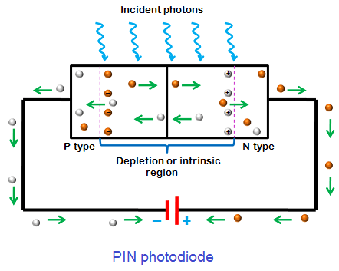
PIN PHOTODIODE

Slide 19
PIN PHOTODIODE
PIN photodiodes are developed from the PN junction photodiodes. The operation of PIN photodiode is similar to the PN junction photodiode.
The PIN photodiode is developed to increase the minority carrier current and response speed. PIN photodiodes generate more electric current than the PN junction photodiodes with the same amount of light energy.

Slide 20
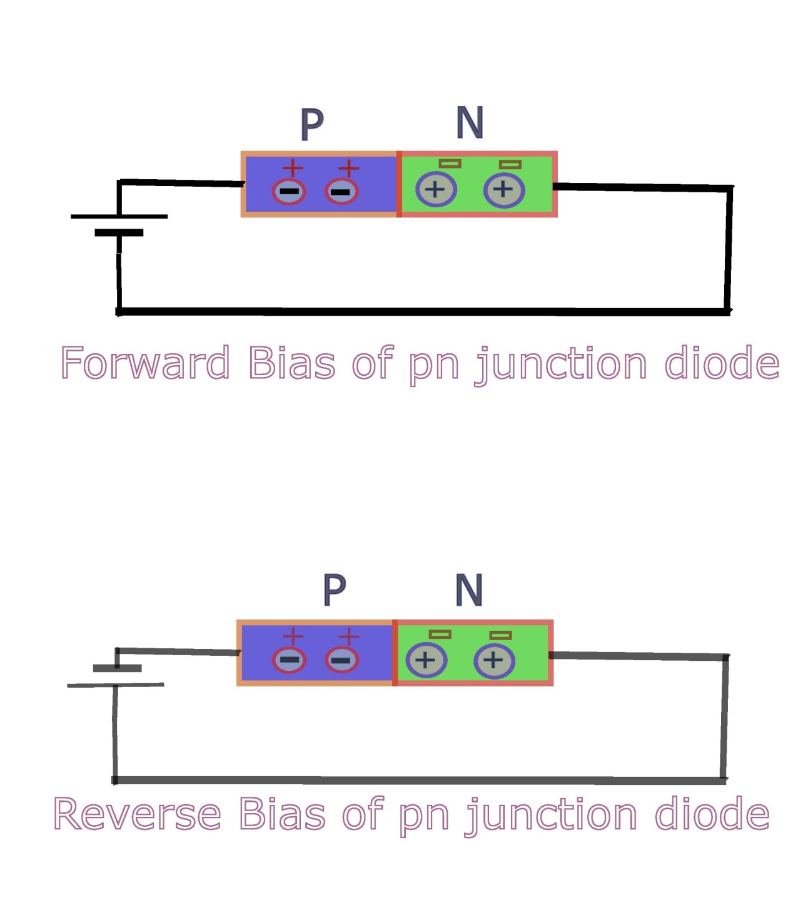
A PN junction photodiode is made of two layers namely p-type and n-type semiconductor whereas PIN photodiode is made of three layers namely p-type, n-type and intrinsic semiconductor.
In PIN photodiode, an addition layer called intrinsic semiconductor is placed between the p-type and n-type semiconductor to increase the minority carrier current.

Slide 21
AVALANCHE DIODE
Avalanche Diode Mode: Avalanche diodes operate in a high reverse bias condition, which permits multiplication of an avalanche breakdown to each photo-produced electron-hole pair. This outcome in an internal gain in the photodiode, which slowly increases the device response.

Slide 22
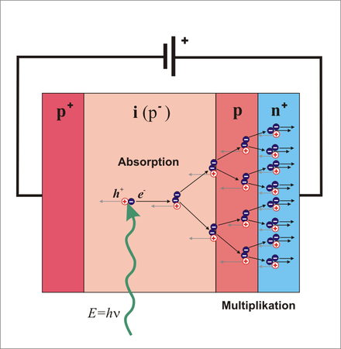
AVALANCHE PHOTODIODE

Slide 23

OBJECTIVES AND LIMITATIONS:
Photodiode should be always operated in reverse bias condition.
Applied reverse bias voltage should be low.
Generate low noise
High gain
High response speed
High sensitivity to light
Low sensitivity to temperature
Low cost
Small size
Long lifetime
High Gain
Longer Lifetime
Low Noise

Slide 24
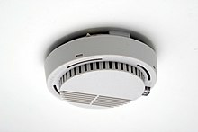
APPLICATIONS:
The various applications of photodiodes are:
Compact disc players
Smoke detectors
Space applications
Photodiodes are used in medical applications such as computed tomography, instruments to analyse samples, and pulse oximeters.
Photodiodes are used for optical communications.
Photodiodes are used to measure extremely low light intensities.
Smoke Detector

